Slide 1
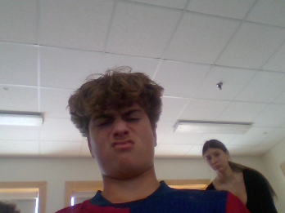
DATE
Noah
Citizenship 9
Insert some kind of cool picture here

Slide 2
TABLE OF CONTENTS
TABLE OF CONTENTS
WHERE
1
2
3
4
Personal
Community
Global
Aspirational

Slide 3
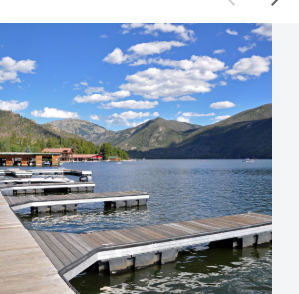
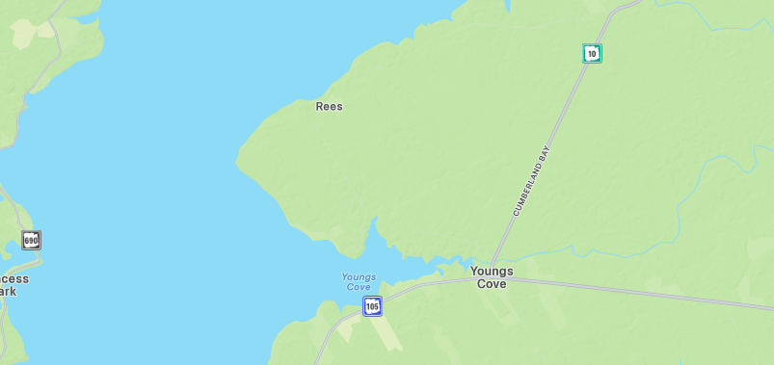
The Personal Place
Cit 9 WHERE
MAP SCREENSHOT (from Bing Maps) | My grandparents cottage means so much to me and my family we spend big events there and we love going there its my favorite place ever and i love going there every year its very important to me and my family! | IMAGE
Notes:
The Personal Place
Reflection: Write a paragraph about a personal place that holds significance for you.
Guiding Questions:: In a second section, describe how your personal perspective shapes the way you see and feel about this place. What stories or memories are tied to this specific location?

Slide 4
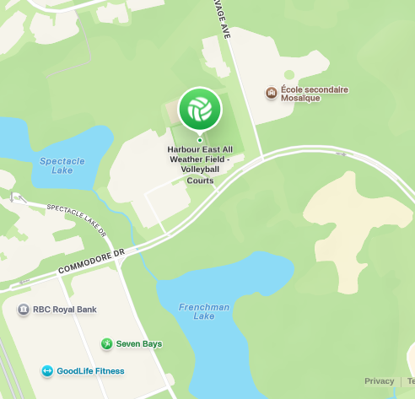
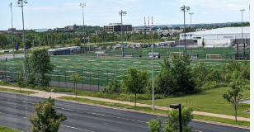
The Community Place
Cit 9 WHERE
MAP SCREENSHOT | Harbour east its a soccer field that i go to almost every single day i really enjoy going there and i have also had many of my big achievements happen there like making aaa winning gold coaching my first tournament playing my first game the list goes on and that's why its my favorite place! | IMAGE
Notes:
Reflection: Write about a significant place in our local community. Tell the story of the place! Who owns it? Why do you like it? Describe something that happened there that you remember.

Slide 5
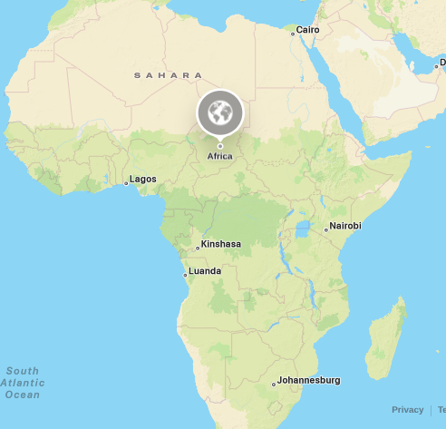
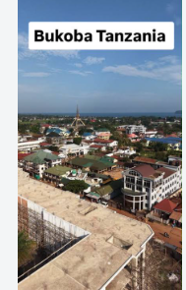
The Global Place
Cit 9 WHERE
MAP SCREENSHOT | The place that is the biggest part of my family history is definitely africa my grandfather was an indian ismiley born there along with his 6 siblings he talks about it all the time about the food the sports everything. So when we got to go there it was amazing seeing all the places we heard my grandfather talking about . it's always been a big part of my family and a big part of me and we go tp the jamaat khana. | IMAGE
Notes:
Reflection: Write a story about a place in the world that is part of your family's story.
Guiding Questions: Tell the story of how you and/or your family are connected to this place.
What traditions or values from this place have been passed down to you?
How does this connect to your cultural identity, including things you do and who you are?

Slide 6
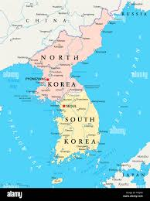
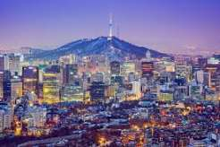
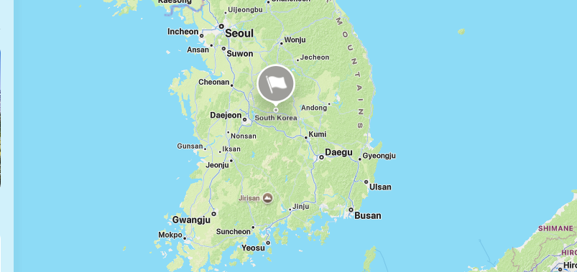
The Aspirational Place
Cit 9 WHERE
MAP SCREENSHOT | I have always always wanted to go to korea! It seams amazing from everything i have heard and it would so fun. I also want to go because my parents moved there and lived there for 2 years as english teachers and they always tell me about how good the food was and considering that i love korean food it would be so fun to eat it from the country it originated from. I also have lots of friends from korea who say it's amazing | IMAGE
Notes:
Reflection: Write a story about a place in the world that is part of your family's story.
Guiding Questions: What draws you to this place? What do you hope to learn or experience there? How does this place fit into your hopes for the future?

Slide 7
The Aspirational Place
Cit 9 WHERE
Soundtrack of your life The manifesto | Post the youtube link here https://www.youtube.com/watch?v=6JIv1l96zN0 | What’s the story on the song? Write here! My dad played this song alot at first i thought it was awful but as time went on i grew to enjoy the song and on my vacation a while back i started to listen to it on my own and i really liked it and now its my favorite song because me and my dad both enjoy it so i feel a connection when we listen to it together.
Notes:
Reflection: Write a story about a place in the world that is part of your family's story.
Guiding Questions: What draws you to this place? What do you hope to learn or experience there? How does this place fit into your hopes for the future?

Slide 8
THANK YOU

